Slide 1
Empowering nhs decision makers
Through connected data

Slide 2
contents
Brief introduction – Us and our Partnerships
Our Vision – the power of information to drive organisation wide change
Success stories
Questions

Slide 3
ABOUT
QLICKIT
Experts in helping organisations use their data more effectively
Our values as a Yorkshire business
Highly specialised service provider
Around 200 customers - from single users to large 10,000+ user enterprises
NHS expertise

Slide 4
OUR partnerships
- Data Analytics Platform
Collaborative Planning Solution -

Slide 5
OUR partnerships
- Patient Pathway Management
Collaborative Solutions -

Slide 6
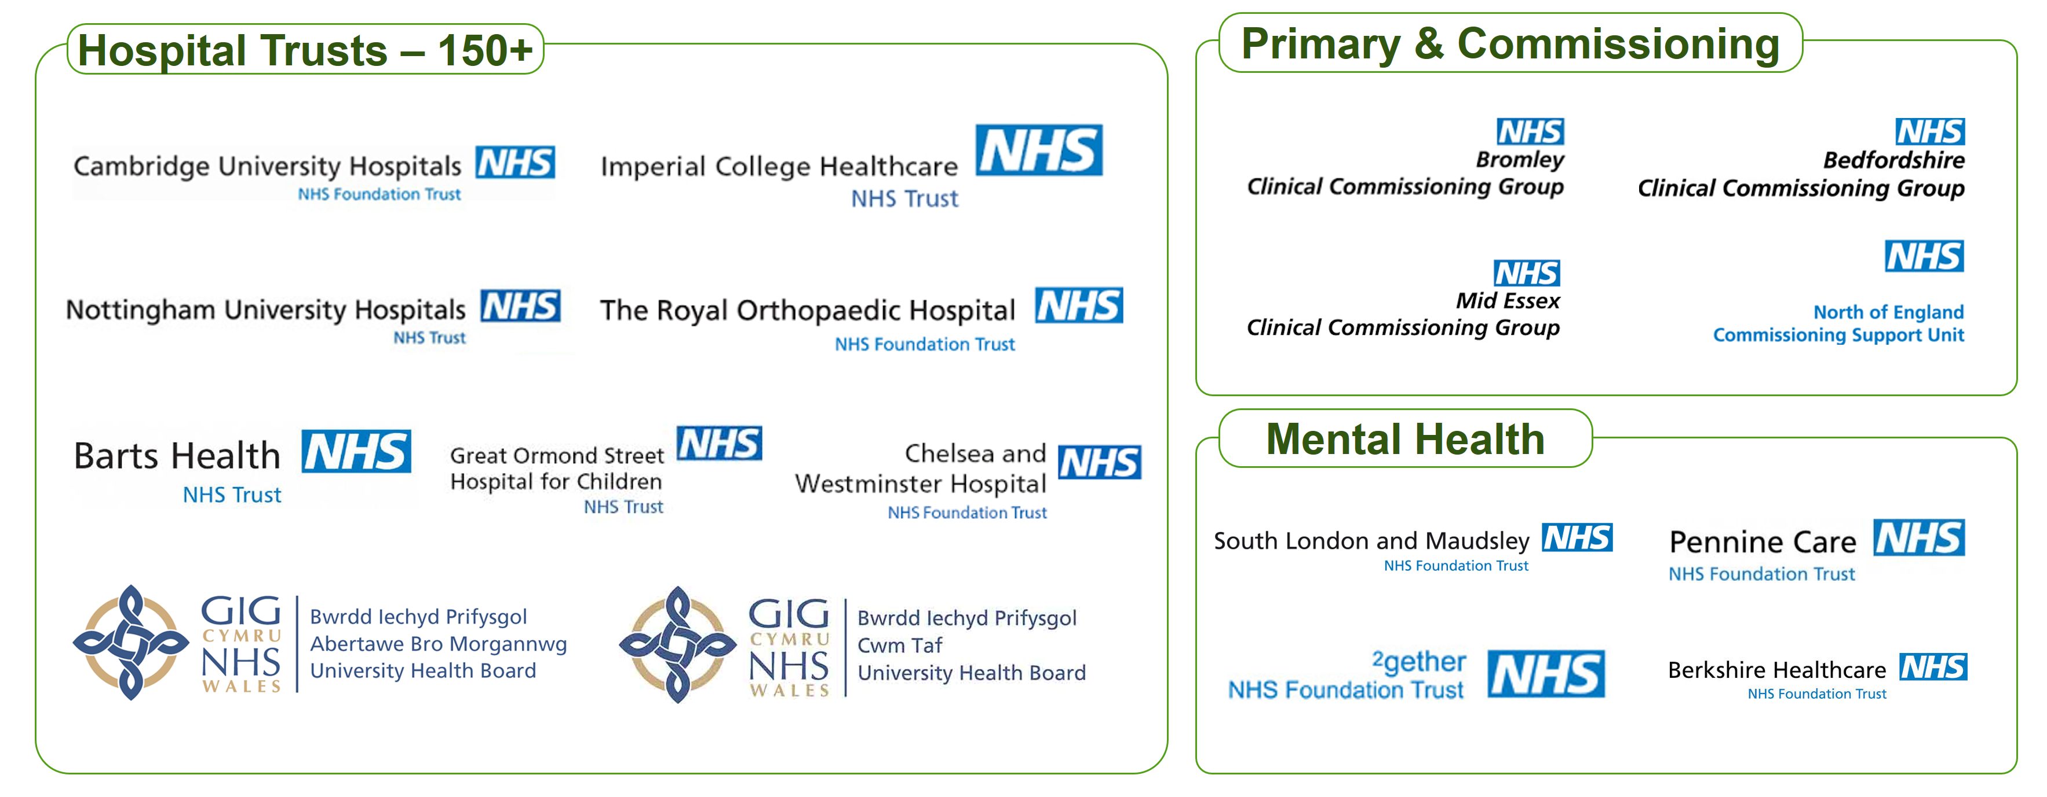
OUR partnerships

Slide 7
The
challenge
“Accountable Care”
“Strategic Transformation Partnerships”
“Future Operating Model”
… any more!! - what will make them work – this time!!
… Culture …..

Slide 8
The
challenge

Slide 9
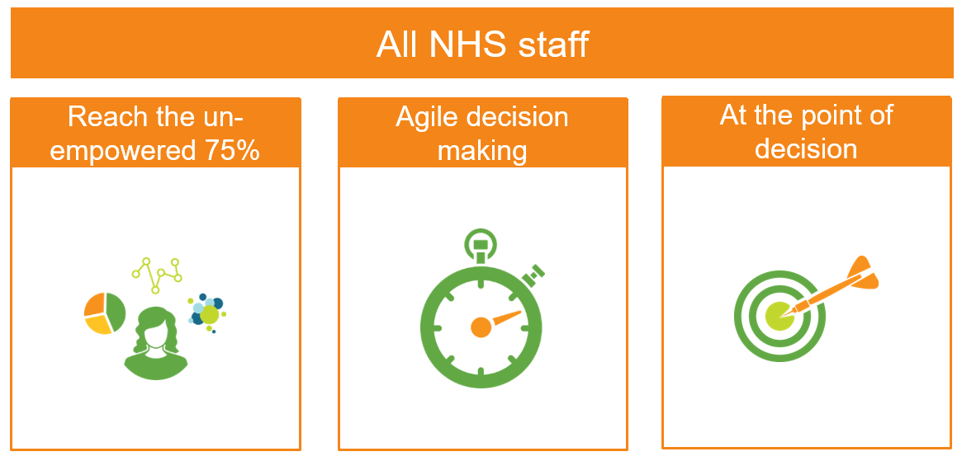
The
challenge

Slide 10
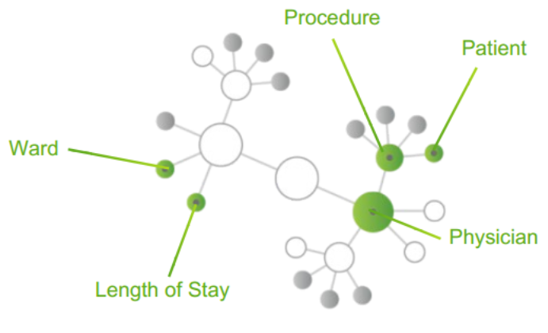
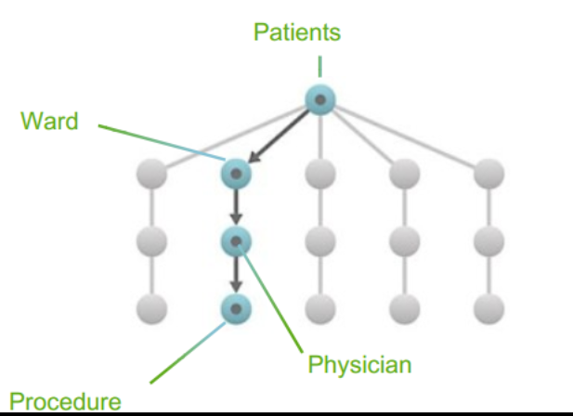
how?
Qlik’s Associative Model
Through the technology:
Associative difference
Full spectrum of analytics use cases (self service visualistion to guided analytics),
Not a linear query tool
Partnership
Methodology and expertise
Query Based Visualization and Traditional BI

Slide 11
partnership
stories
A SINGLE VERSION of the truth from a SINGLE PLACE for THE WHOLE TRUST
With over 40 applications, information is in the hands of clinicians and managers
Strategic Partner since 2011, over 1000 licences

Slide 12
partnership
stories
TheatrePro Application cost £20k to develop, but is delivering £2mil of benefits each year.
’This has changed my life’

Slide 13
partnership
stories
Organisation-wide Digital Transformation project
Agile deployment - achieved goals on time
Maximised engagement – at all levels
So successful that their approach has been described as ’The Wolverhampton Way’ by other authorities

Slide 14
partnership
stories
Instilling a culture of data literacy through training and best practice
Information in the hands of clinicial and management teams who are confident in interrogating the data
The governed data framework means that admissions and waiting time data is all in one place and being utilised live by the clinical team

Slide 15
What’s
Next?
Connected Planning
Data Literacy

Slide 16
CONNECTED
PLANNING
Exterminate ” Spreadsheet Spaghetti for planning”
Data entry anywhere with instant update
Statistical forecasting based on history and AI cognitive input

Slide 17
DATA
LITERACY
Qlik Continuous Classroom
qcc.qlik.com

Slide 18
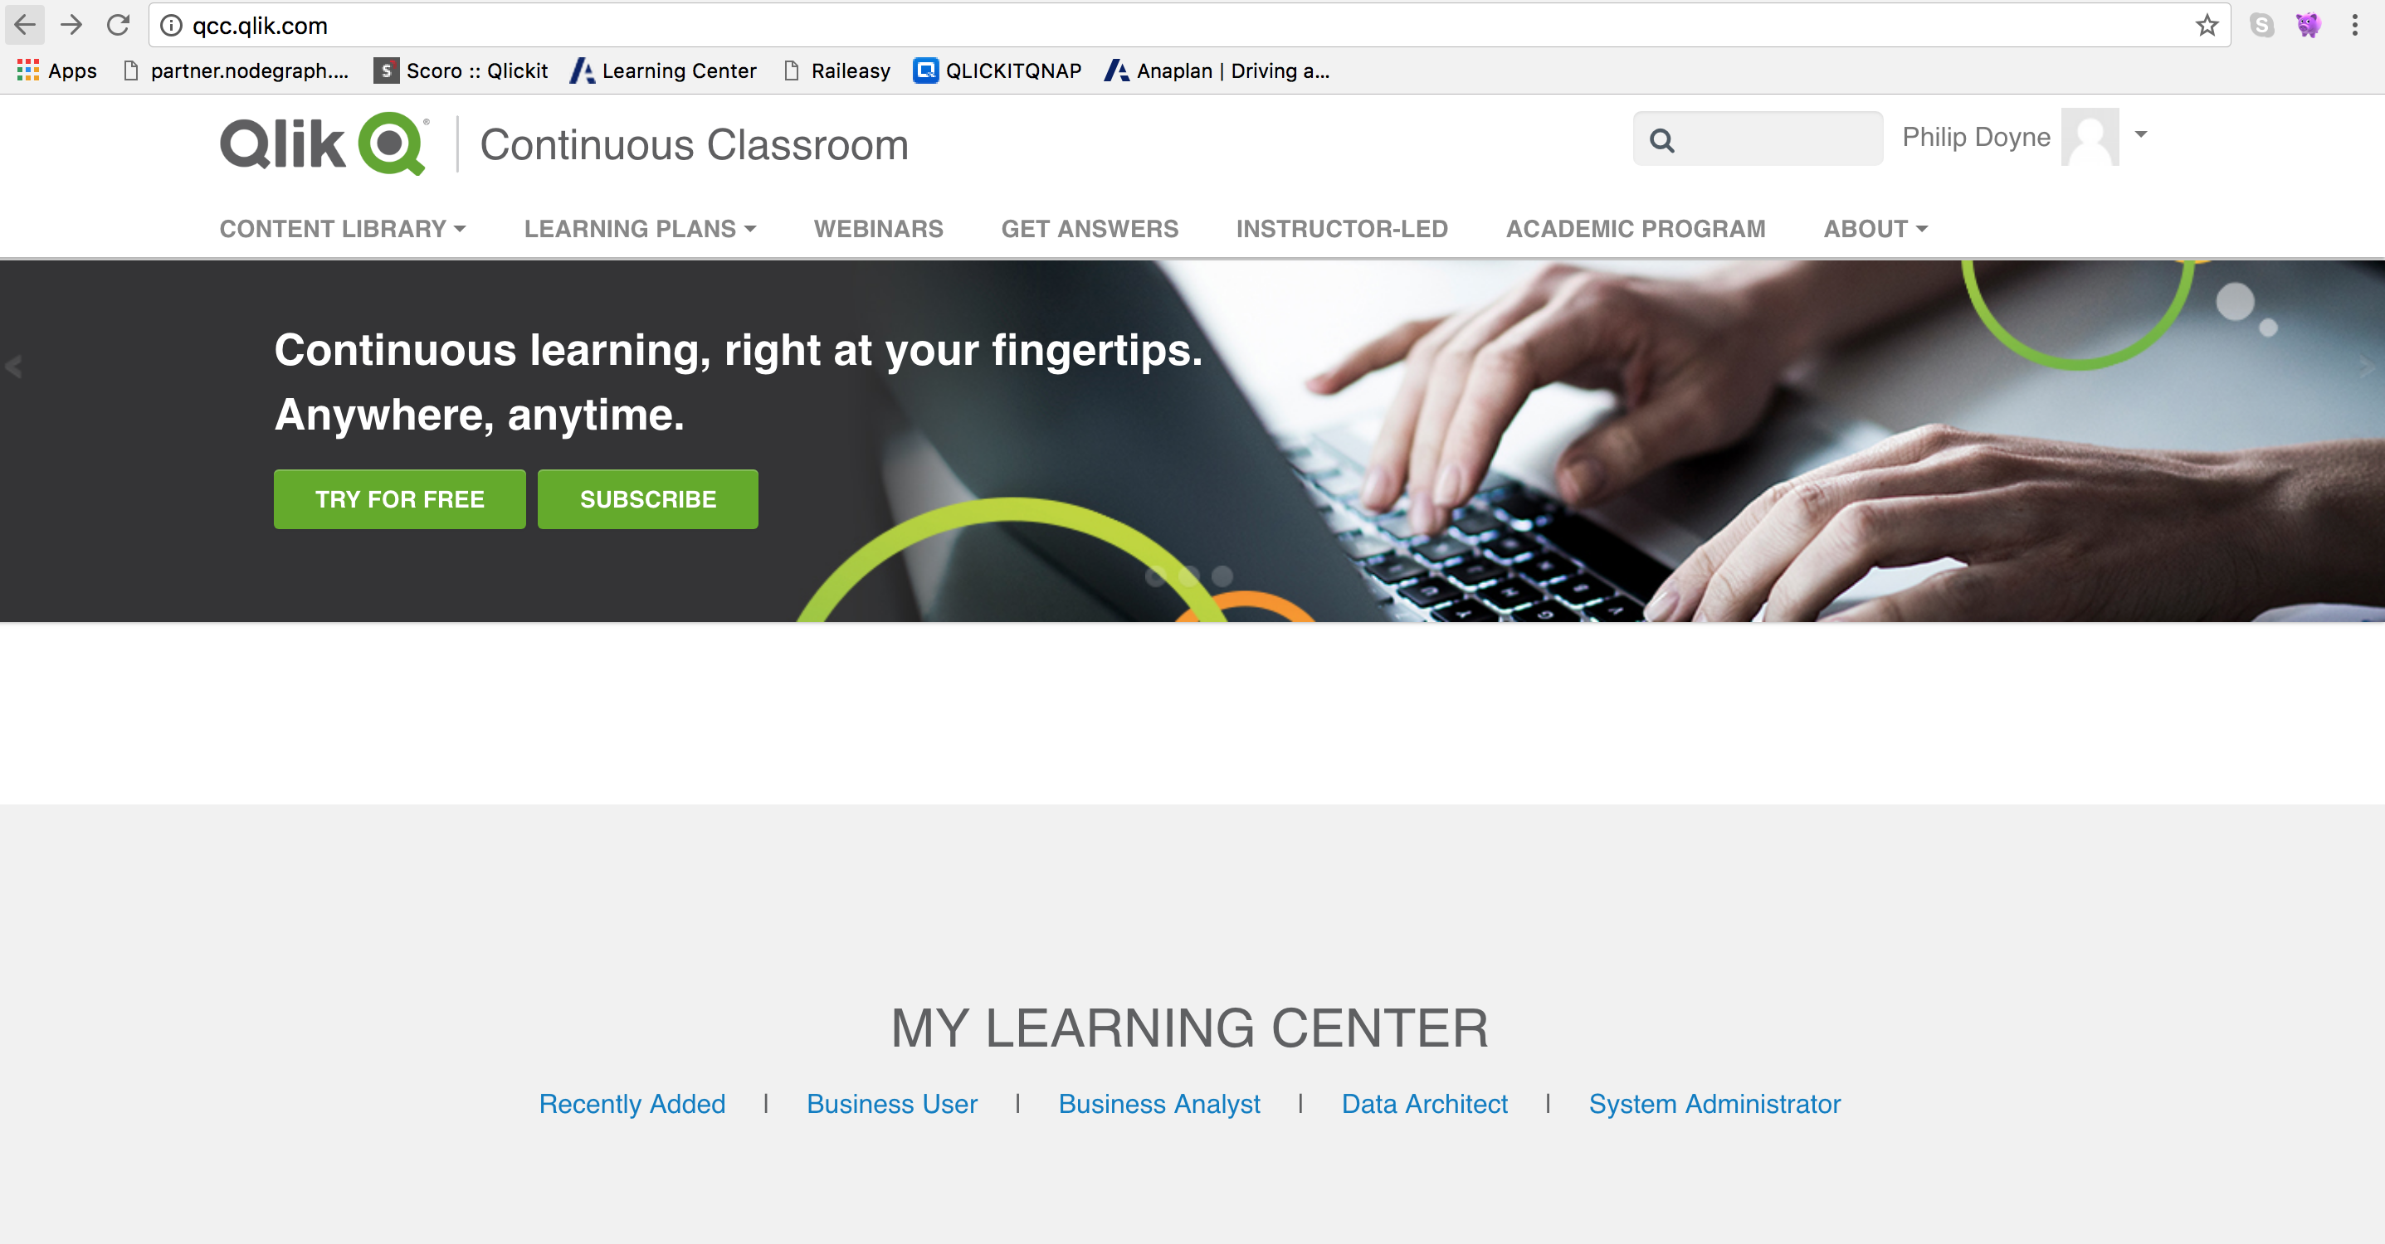
GETTING STARTED

Slide 19
DATA
LITERACY

Slide 20
QUESTIONS?

